Slide 1
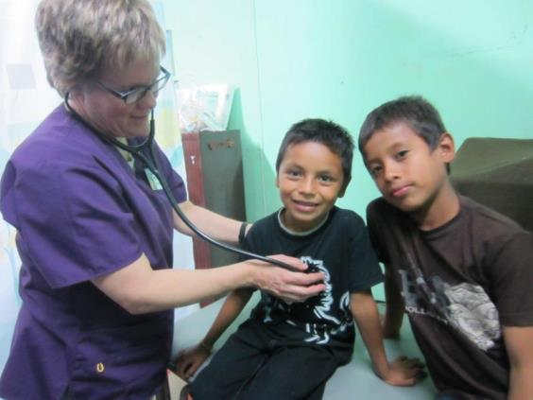
Missions of healing
February 2013
Northern Micro-Region + Jan 30 – Feb 13
Central South Micro-Region + Feb 16 - 23

Slide 2
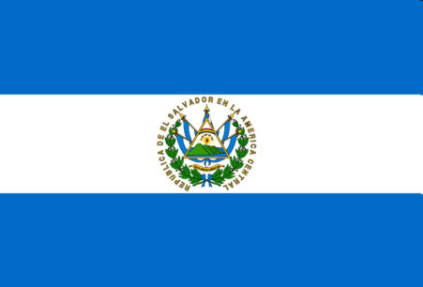
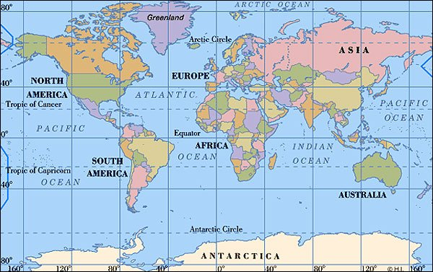
Where in the World is El Salvador?

Slide 3
A few of the Health & wellness issues in el salvador
Climate change and natural disasters impact food security
Poverty limits access to healthy foods and medicines
Contaminated soil and water cause skin infection, internal infection and kidney disease
Mosquitoes cause dengue
Many people with indigenous heritage struggle with diabetes
Hauling water and wood, working in the fields and domestic work cause chronic pain and aggravate arthritis
Air pollution, dusty fields, and indoor cooking fires irritate eyes and cause allergy and asthma attacks

Slide 4
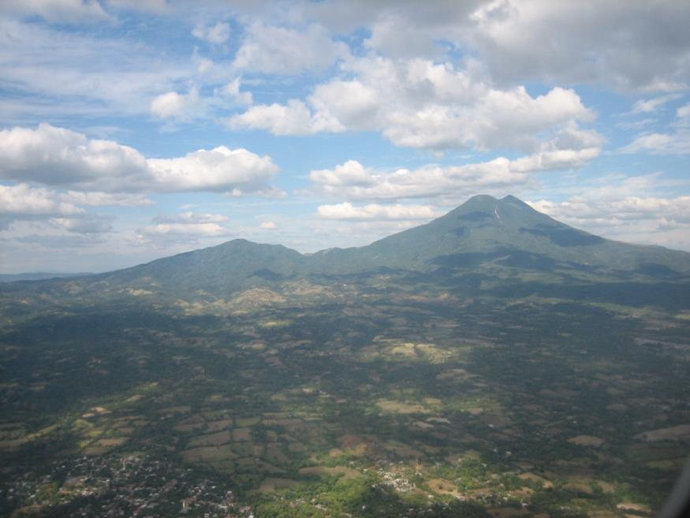
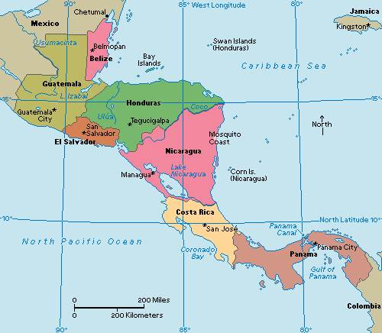
El Salvador’s location brings nature’s beauty and nature’s challenges…

Slide 5
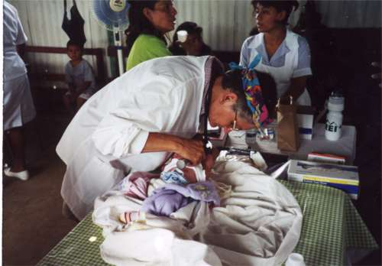
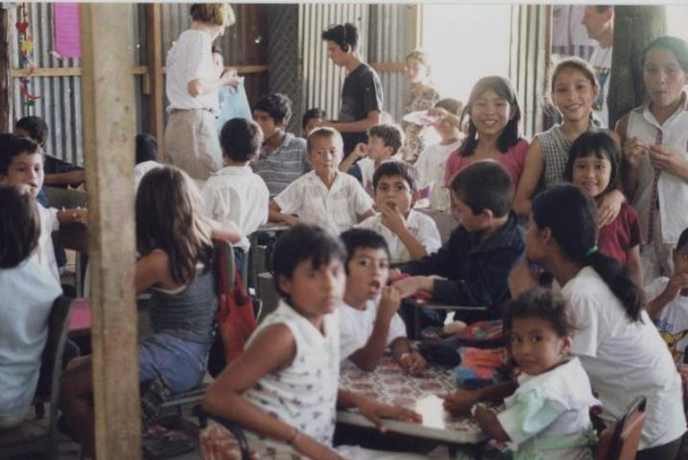
The Greater Milwaukee Synod and Salvadoran Lutheran Church have been working together to bring holistic healing to children and adults since 2000.
Physical Exams
Learning for Kids
Los Héroes, St. John’s & All Peoples in August 2000

Slide 6
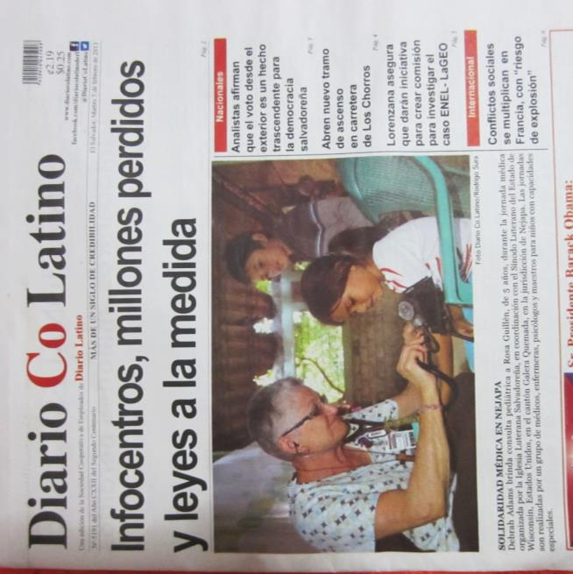
Over the years, the mission expanded and served people in more locations. In 2013, the Greater Milwaukee Synod was asked by the Salvadoran Lutheran Church to hold two Missions of Healing, one in the north, and one in the south, with two sets of volunteers. The hope is to add a third Mission of Healing in the eastern part of the country (a one day trial run was held there in 2012.)

Slide 7
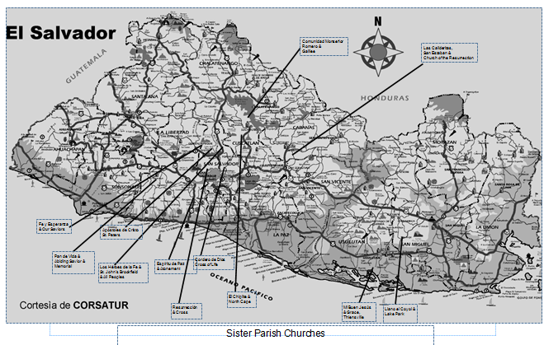
Greater Milwaukee Synod Churches with Sister Churches in El Salvador
Galilee
Church of the Resurrection
Our Savior’s
St. Peter
Cross of Life
Abiding Savior
St. John’s & All Peopless
Atonement
North Cape
Cross
Grace
Lake Park

Slide 8
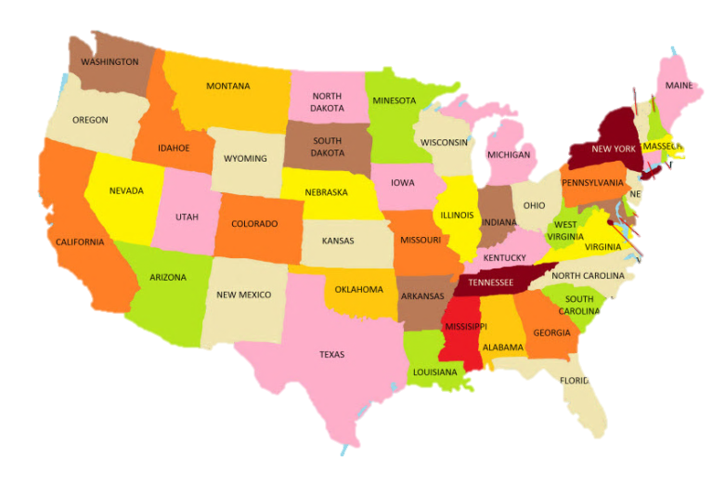
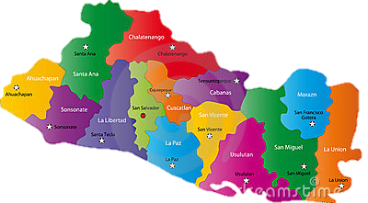
The Greater Milwaukee Synod established a MOH Roundtable to coordinate the missions. Milwaukee area congregations which have sister church relationships in each region provide leadership for the mission in their region.
Volunteers include folks from the Milwaukee area, northern Minnesota, the St. Paul Area Synod and other parts of the US, a broad group of Salvadoran Lutheran Church pastors and lay leaders and volunteer medical personnel from El Salvador. In 2013, team members came from as far away as Ontario, Maryland and Arizona!

Slide 9
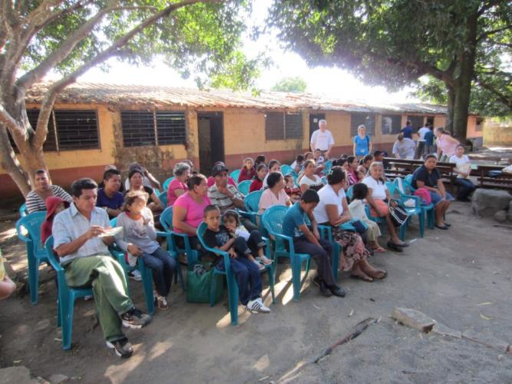
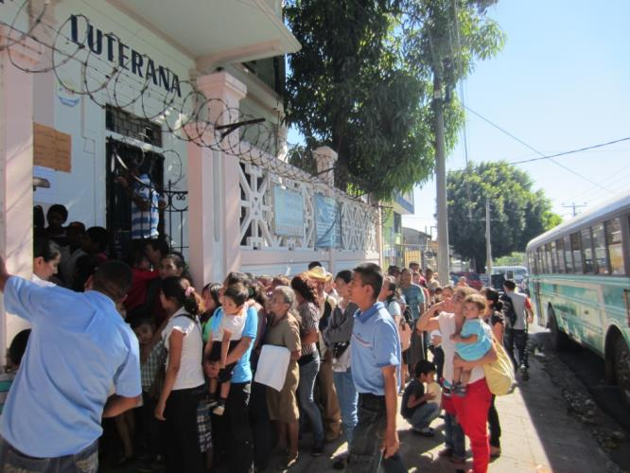
2 Missions + 2 teams + 2 locations
Week #1
Fe y Esperanza
Nejapa
Week #2
Clínica Luterana Salvadoreña
San Salvador

Slide 10
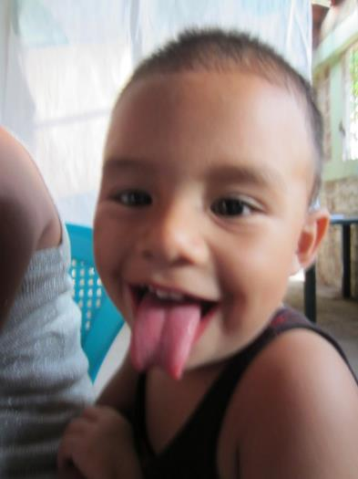
MisiÓn de sanaciÓn integral
Holistic Mission of Healing
What does holistic healing mean?

Slide 11
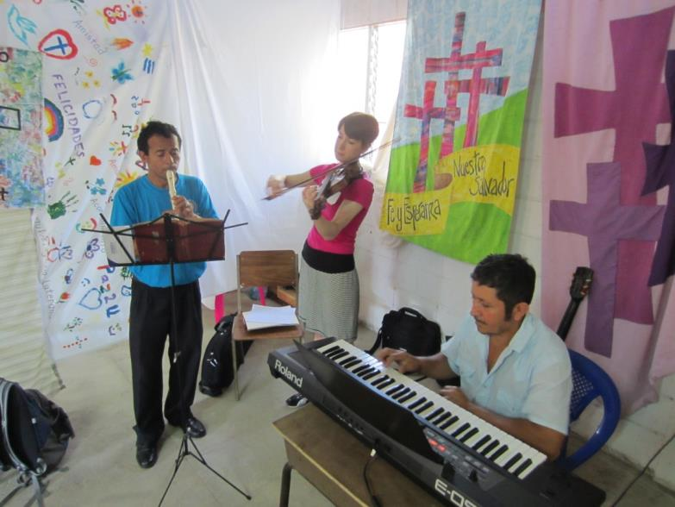
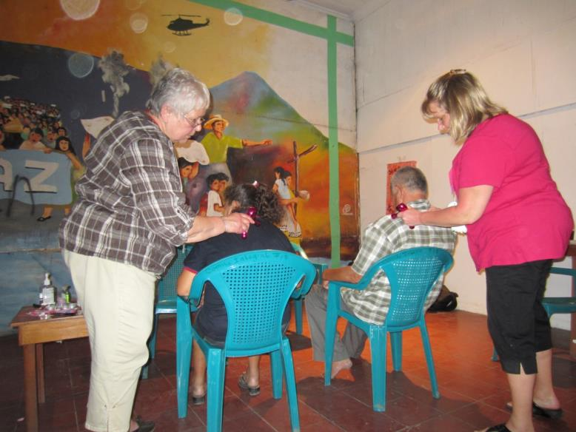
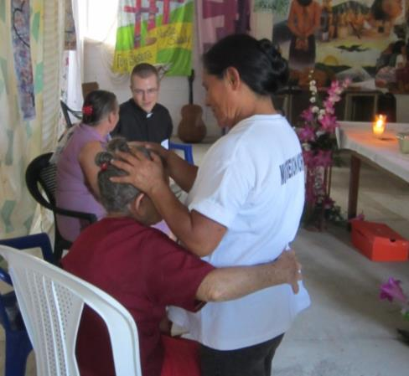
Spiritual
Fe y Esperanza
Clínica Luterana

Slide 12
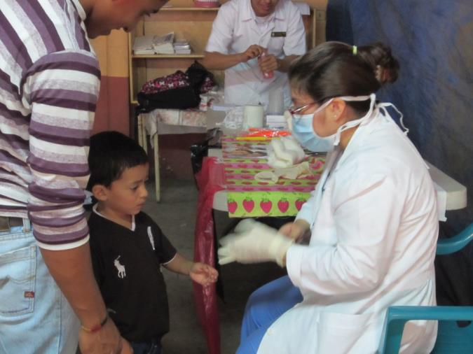
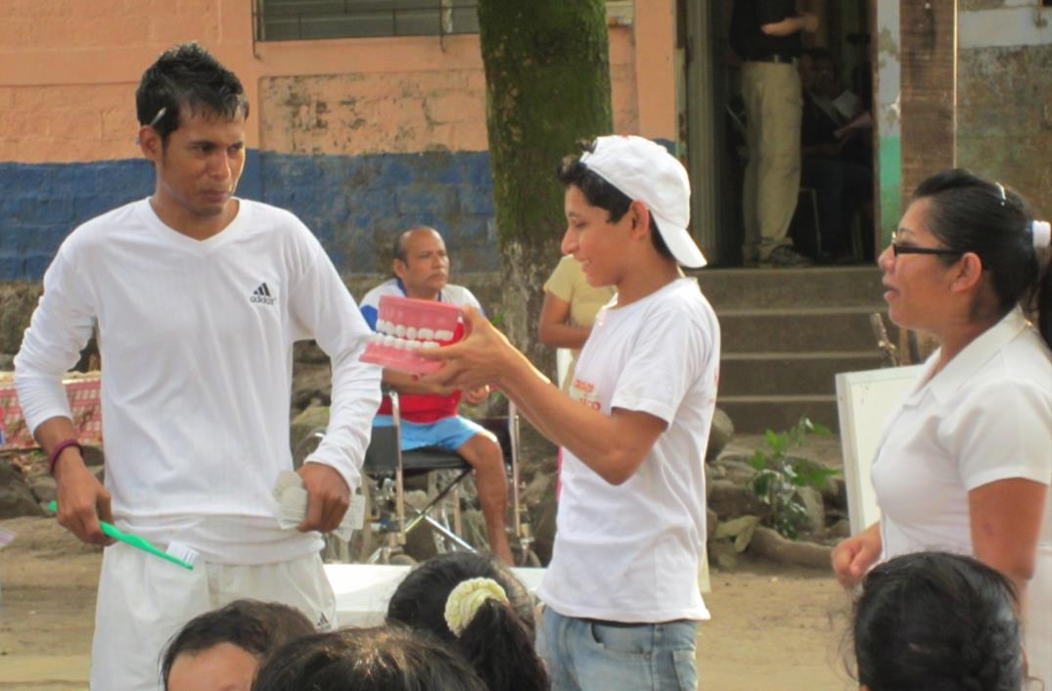
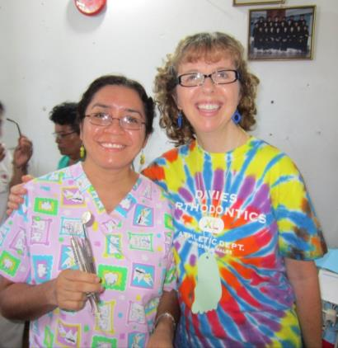
Oral Hygiene & dental exams
Fe y Esperanza
Fe y Esperanza
Clínica Luterana

Slide 13
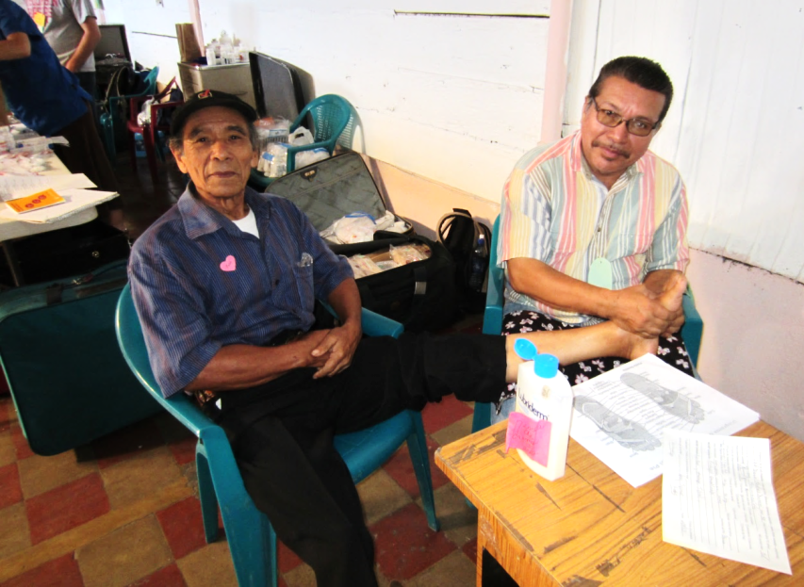
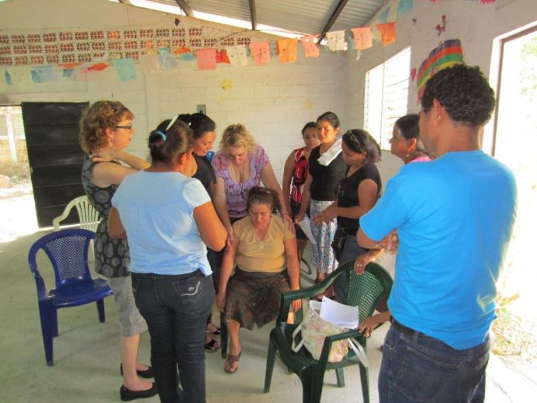
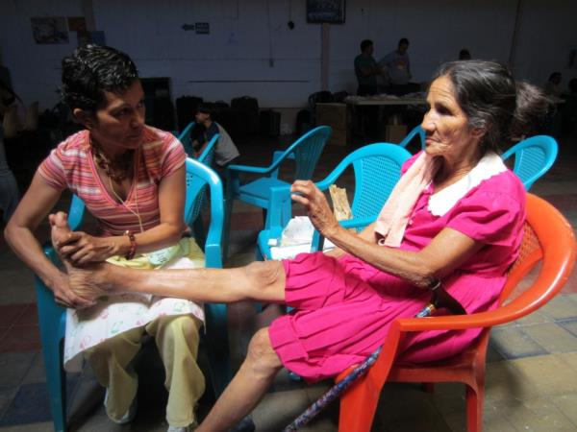
Reflexology
Fe y Esperanza
Clínica Luterana

Slide 14
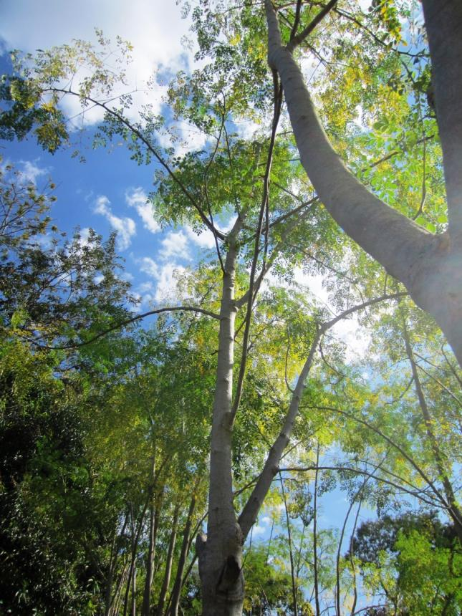
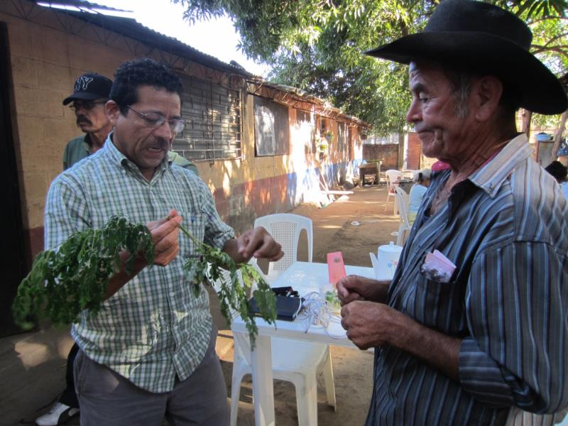
Natural medicines
Fe y Esperanza

Slide 15
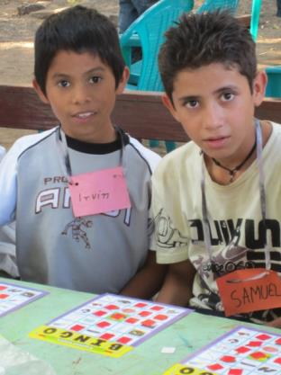
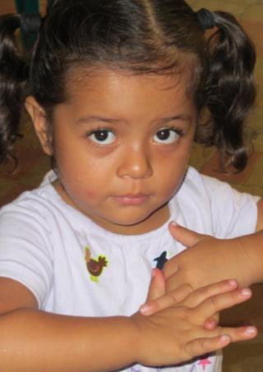
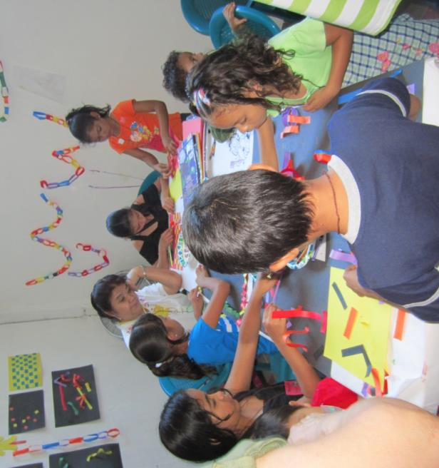
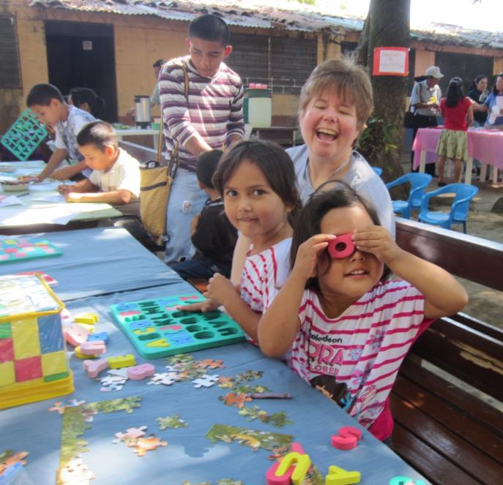
Children’s zone
Clínica Luterana
Fe y Esperanza

Slide 16
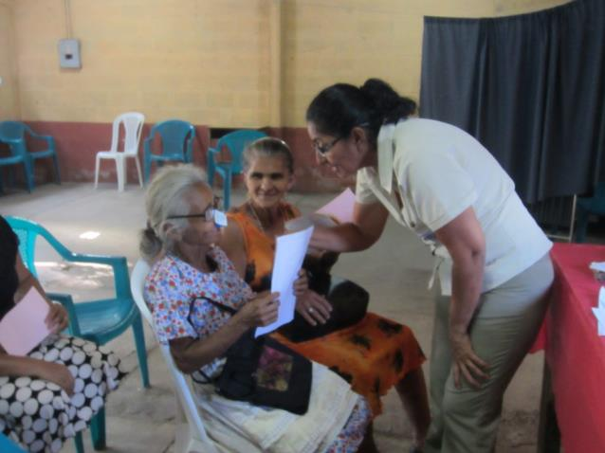
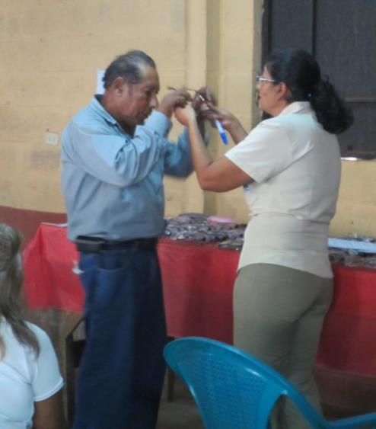
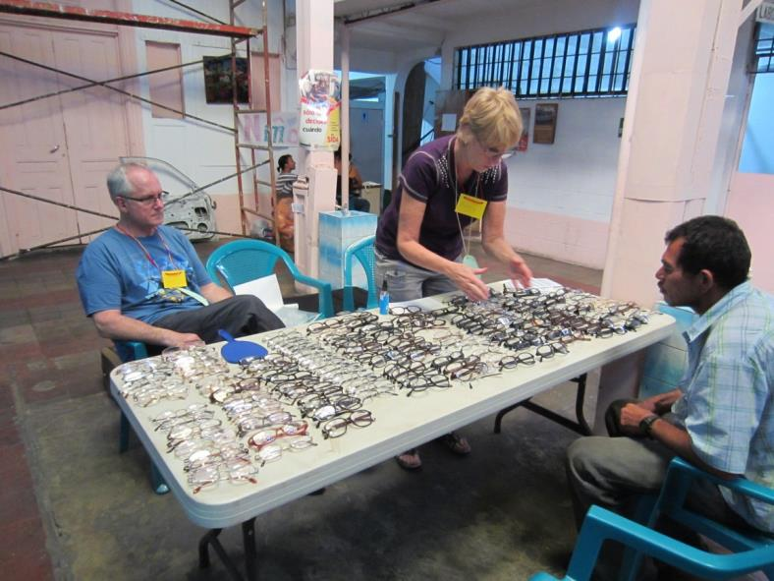
READING GLASSES
Fe y Esperanza
Fe y Esperanza
Clínica Luterana

Slide 17
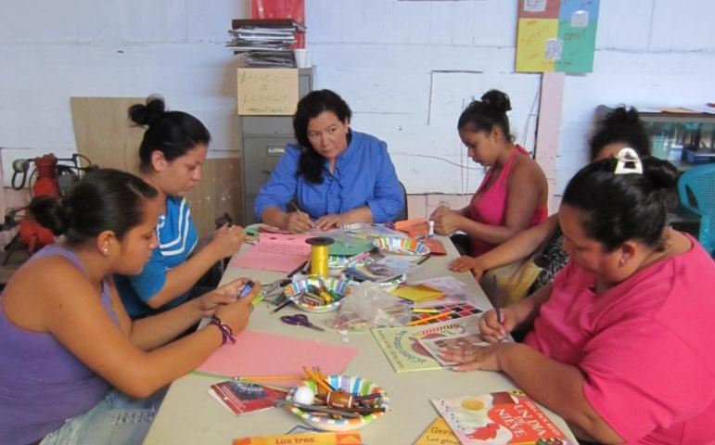
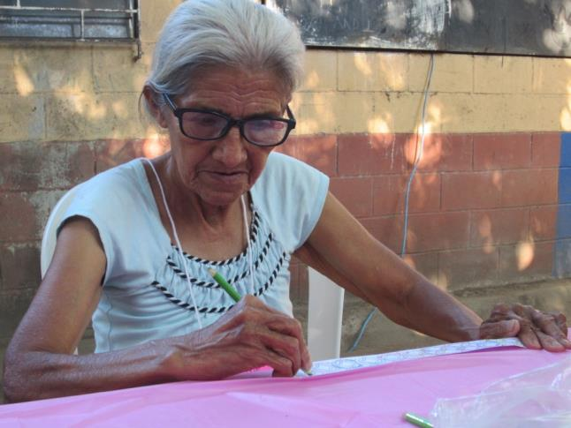
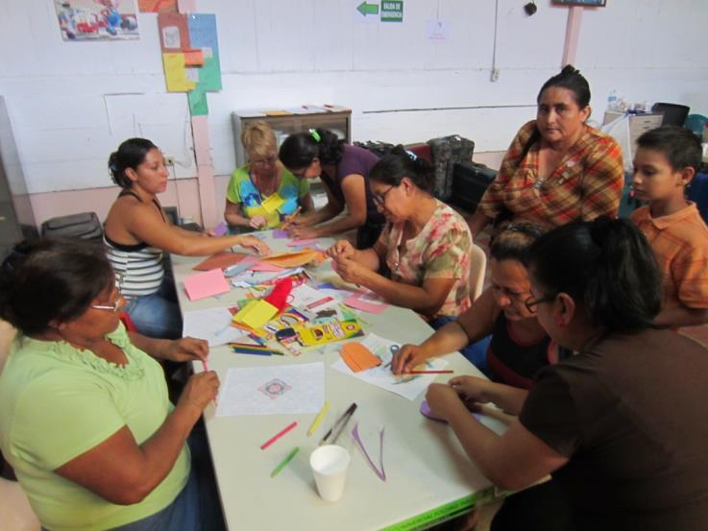
Adult play zone
Clínica Luterana
She got her new glasses and headed right to the coloring
Clínica Luterana
Fe y Esperanza

Slide 18
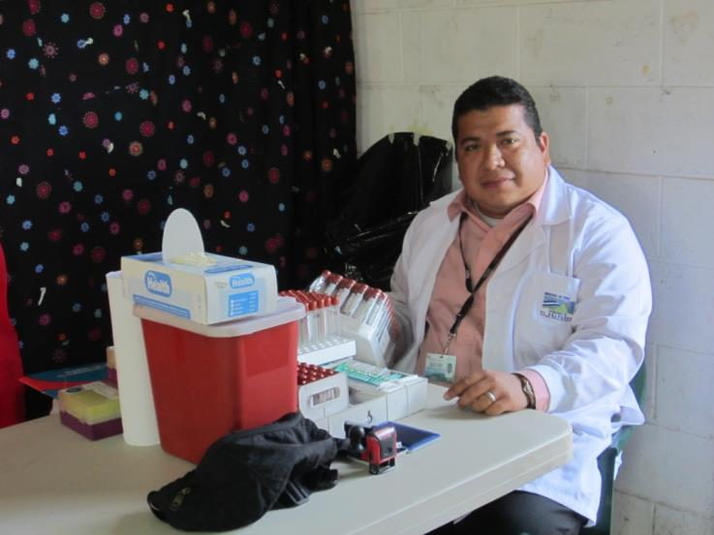
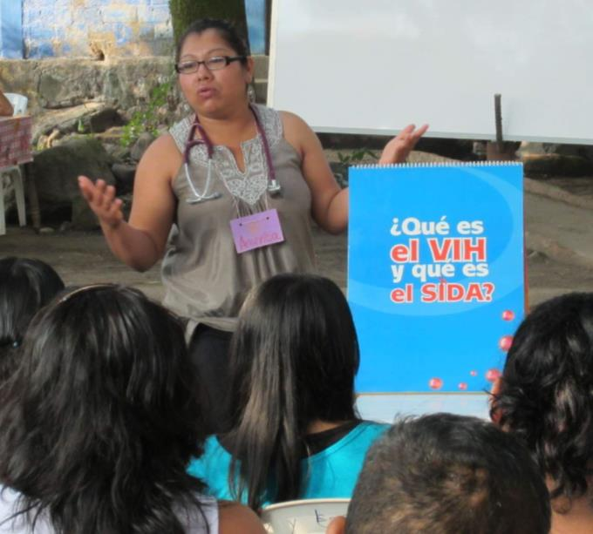
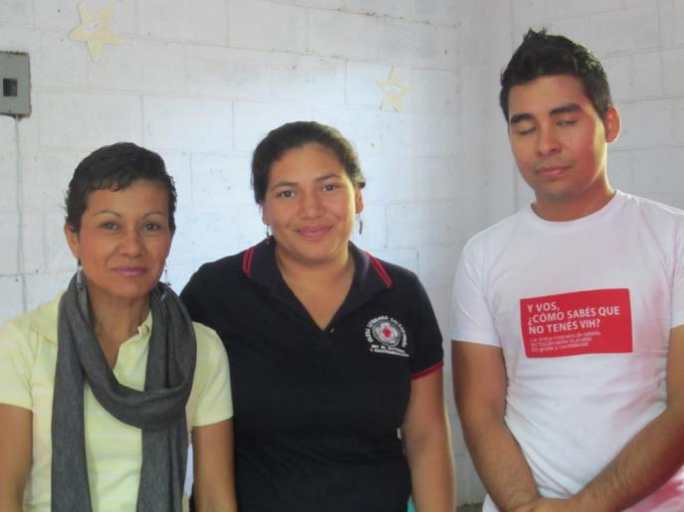
HIV & STD’s

Slide 19
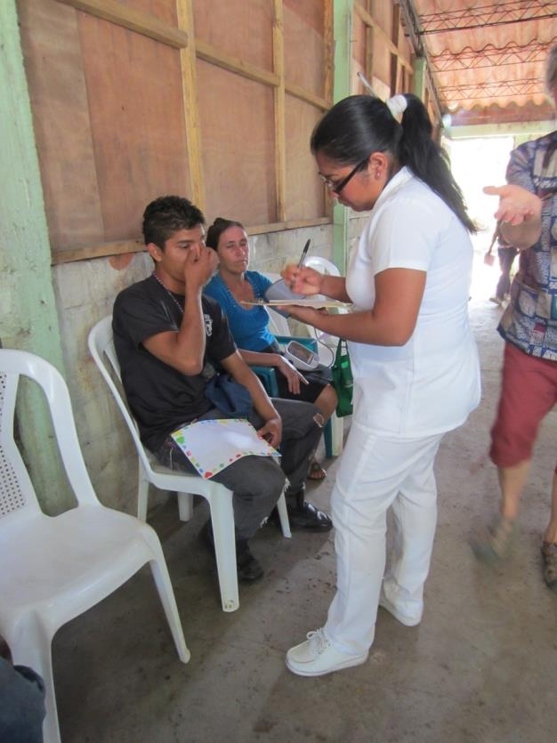
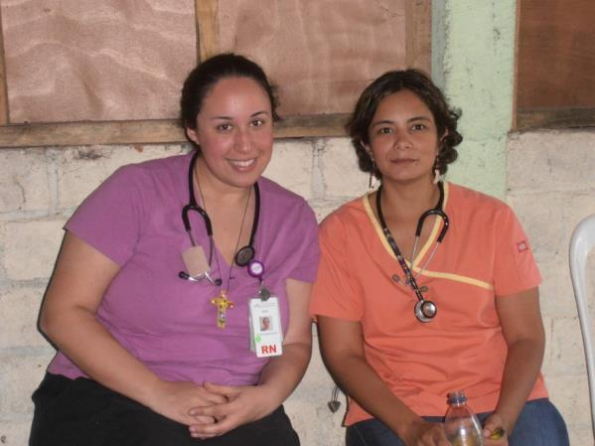
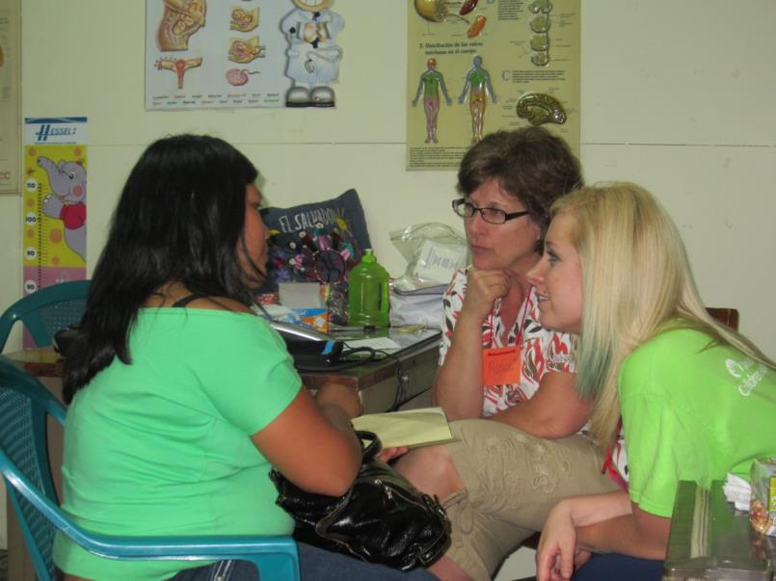
triage
Fe y Esperanza
Clínica Luterana
Fe y Esperanza

Slide 20
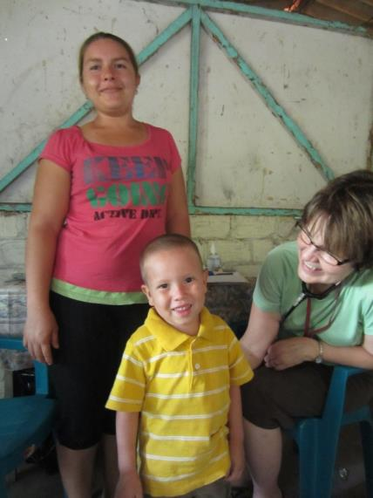
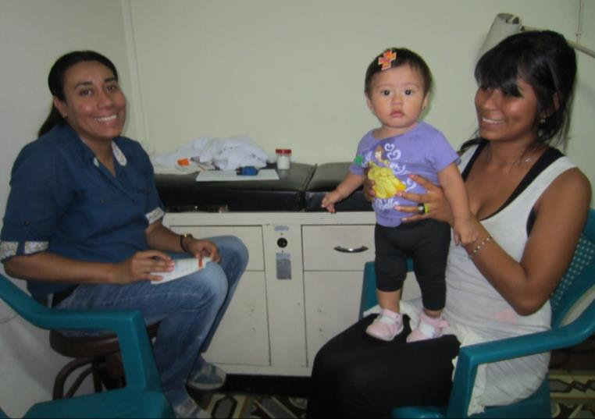
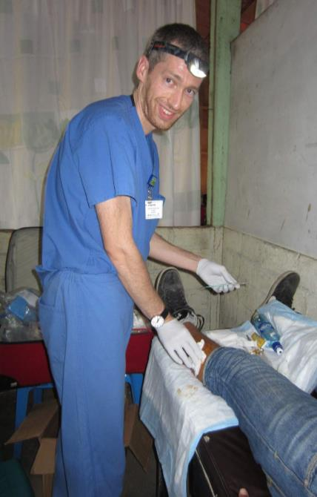
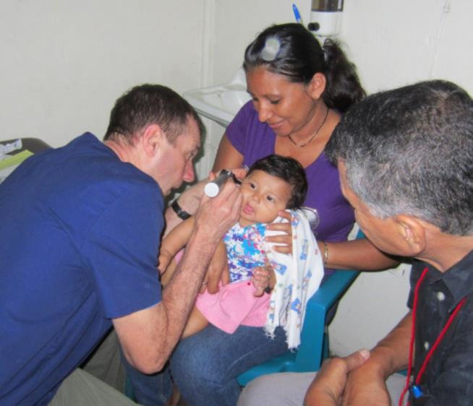
Physical exams
Clínica Luterana
Fe y Esperanza
Clínica Luterana
Fe y Esperanza

Slide 21
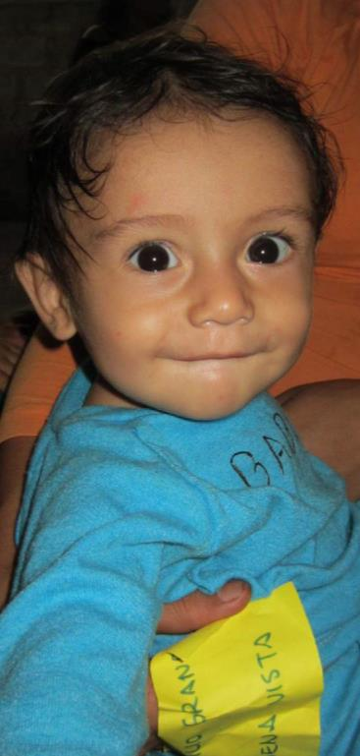
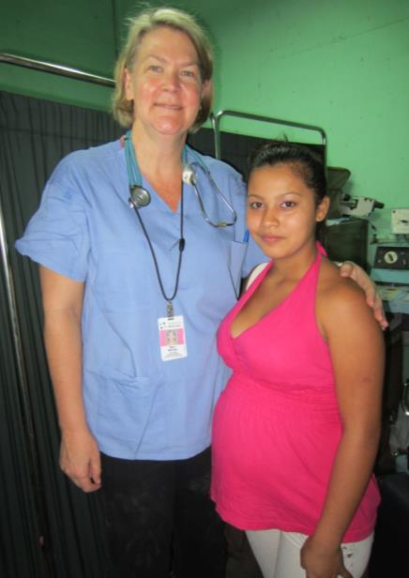
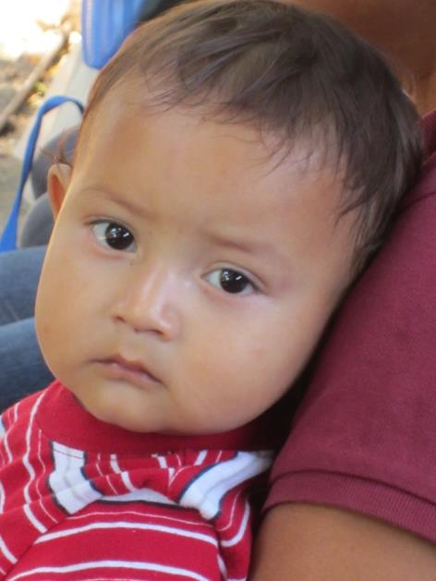
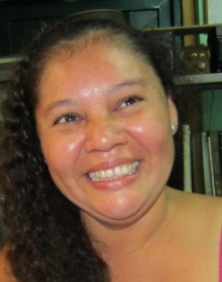
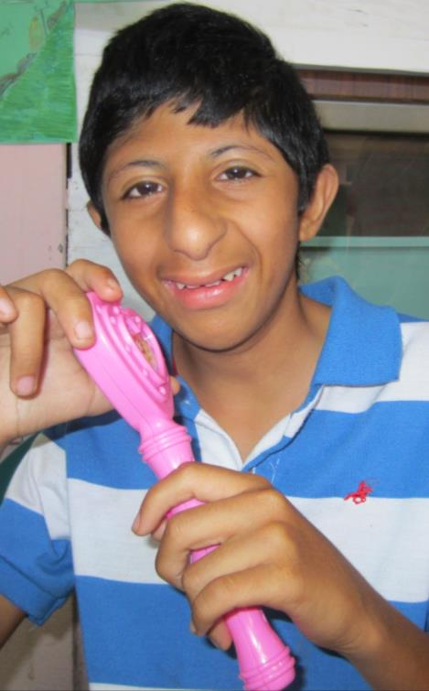



Slide 22



Pharmacy
Fe y Esperanza
Clínica Luterana

Slide 23



Logistics food, transportation, Registration
Fe y Esperanza
Fe y Esperanza

Slide 24




Casa esperanza
Homeless shelter
Fe y Esperanza
Clínica Luterana

Slide 25

Healing at the women’s prison

Slide 26






fun
Fe y Esperanza

Slide 27



challenges
Medications were seized by customs and it took us 10 days to get them out!

Slide 28



Networking health ministry, Provida, local physicians and clinics

Slide 29




relaxation
Fe y Esperanza

Slide 30



impact
2008
Miguelito
2013

